Slide 1
S/MINE, DKIM, IPSec, and SSL/TLS

Slide 2
Agenda
S/MINE
DKIM
BGP
DNS
IPSec
SSL/TLS

Slide 3
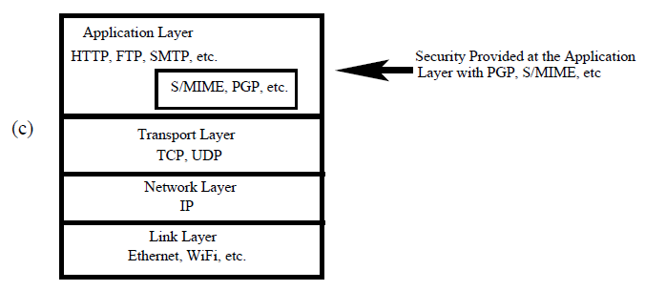
Application Layer
Notes:
S/MIME (Secure/Multipurpose Internet Mail Extensions)

Slide 4
DNS: Domain Name Service
DNS maps symbolic names to numeric IP addresses
(for example, www.hcmus.edu.vn ↔ 172.29.1.16)
root & vn
DNS server
www.hcmus.edu.vn
www.hcmus.edu.vn
NS edu.vn
edu.vn
DNS server
Local
DNS recursive
resolver
NS hcmus.edu.vn
Client
www=IPaddr
hcmus.edu.vn
DNS server

Slide 5
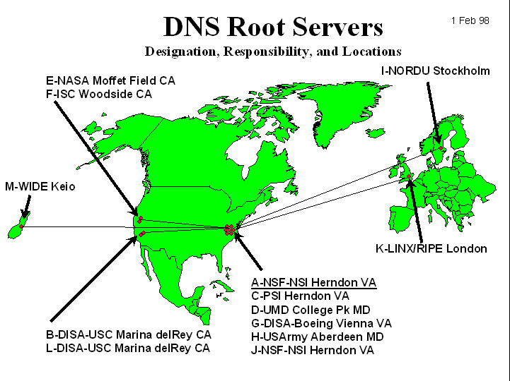
DNS Root Name Servers
Root name servers for top-level domains
Authoritative name servers for subdomains
Local name resolvers contact authoritative servers when they do not know a name
Feb 6, 2007: DoS attack on
root DNS servers

Slide 6
DNS Caching
DNS responses are cached
Quick response for repeated translations
Other queries may reuse some parts of lookup
NS records for domains
DNS negative queries are cached
Don’t have to repeat past mistakes
For example, misspellings
Cached data periodically times out
Lifetime (TTL) of data controlled by owner of data
TTL passed with every record

Slide 7
Cached Lookup Example
root & vn
DNS server
fit.hcmus.edu.vn
edu.vn
DNS server
Local
DNS recursive
resolver
fit.hcmus.edu.vn
Client
fit=IPaddr
hcmus.edu.vn
DNS server

Slide 8
DNS “Authentication”
Request contains random 16-bit TXID
root & vn
DNS server
www.hcmus.edu.vn
www.hcmus.edu.vn
NS edu.vn
edu.vn
DNS server
Response accepted if TXID is the same
Stays in cache for a long time (TTL)
Local
DNS recursive
resolver
NS hcmus.edu.vn
Client
www=IPaddr
hcmus.edu.vn
DNS server

Slide 9
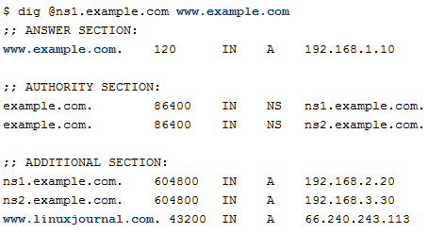
Bailiwick Checking, since 1997
This just means that any records that aren't in the same domain of the question are ignored.
Notes:
We want to find the address ofwww.example.com so we ask a root DNS server for the list of .com DNS servers. The root server gives me a list of .com DNS servers so we pick one and ask it for the list of DNS servers for example.com. If the .com server simply responded with ns1.example.com and ns2.example.com we would be stuck. We are trying to find information about example.com and along the way we are being told to ask the example.com DNS servers for answers. To remedy this chicken and egg problem two "A" records are provided in the additional section to provide the missing link. These are called "glue" records.

Slide 10
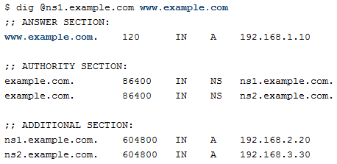
Kaminsky’s exploit 2008
Typical DNS query and response to unknown www.example.com
Notes:
Một response thông thường của request www.example.com. Attacker giả tạo địa chỉ IP của ns1.example.com trong ADDITIONAL SECTION. Nó có thể thoát được Bailiwick checking

Slide 11
DNS Spoofing
6.6.6.6
Trick client into looking up host1.foo.com (how?)
Guess TXID, host1.foo.com is at 6.6.6.6
Another guess, host1.foo.com is at 6.6.6.6
Another guess, host1.foo.com is at 6.6.6.6
host1.foo.com
TXID, host1.foo.com
Local
resolver
ns.foo.com
DNS server
Client
host1.foo.com is at 1.2.3.4
Several opportunities to win the race
If attacker loses, has to wait until TTL expires
… but can try again with host2.foo.com, host3.foo.com, etc.

Slide 12
Exploiting Recursive Resolving
[Kaminsky]
6.6.6.6
Trick client into looking up host1.foo.com
Guessed TXID, very long TTL
I don’t know where host1.foo.com is
Ask the authoritative server at ns2.foo.com
It lives at 6.6.6.6
host2.foo.com
host1.foo.com
TXID, host1.foo.com
Local
resolver
ns.foo.com
DNS server
Client
host1.foo.com is at 1.2.3.4
If attacker wins, all future DNS requests will go to 6.6.6.6
The cache is now poisoned… for a very long time!
No need to win future races!

Slide 13
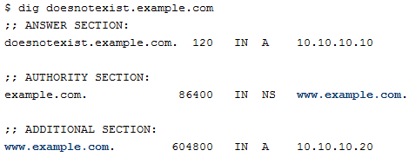
Kaminsky’s exploit
asks for the IP address of doesnotexist.example.com
Attacker replies:

Slide 14
Pharming
Many anti-phishing defenses rely on DNS
Can bypass them by poisoning DNS cache and/or forging DNS responses
Browser: give me the address of www.paypal.com
Attacker: sure, it’s 6.6.6.6 (attacker-controlled site)
Dynamic pharming
Provide bogus DNS mapping for a trusted server, trick user into downloading a malicious script
Force user to download content from the real server, temporarily provide correct DNS mapping
Malicious script and content have the same origin!
Notes:
Pharming là tấn công chuyển hướng người dùng từ một website thật sang website giả bằng cách thay đổi DNS

Slide 15
Solving the DNS Spoofing Problem
Long TTL for legitimate responses
Does it really help?
Randomize port in addition to TXID
32 bits of randomness, makes it harder for attacker to guess TXID
DNSSEC
Cryptographic authentication of host-address mappings

Slide 16
DNSSEC
Goals: authentication and integrity of DNS requests and responses
PK-DNSSEC (public key)
DNS server signs its data (can be done in advance)
How do other servers learn the public key?
SK-DNSSEC (symmetric key)
Encryption and MAC: E_{k}(m, MAC(m))
Each message contains a nonce to avoid replay
Each DNS node shares a symmetric key with its parent
Zone root server has a public key (hybrid approach)
Notes:
Middle-in-man

Slide 17
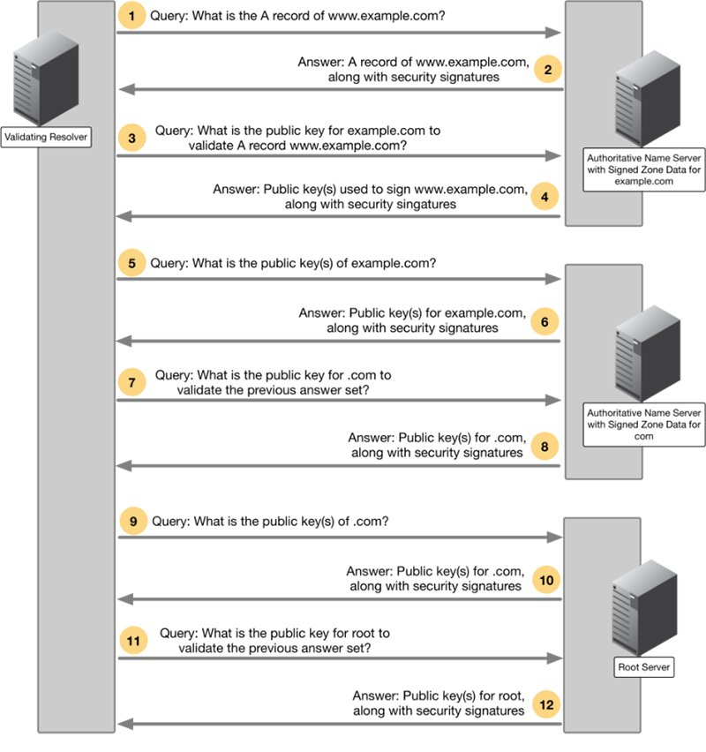
DNSSEC
https://www.infoblox.com/dns-security-resource-center/dns-security-solutions/dns-security-solutions-dns-security-extensions-dnssec/

Slide 18
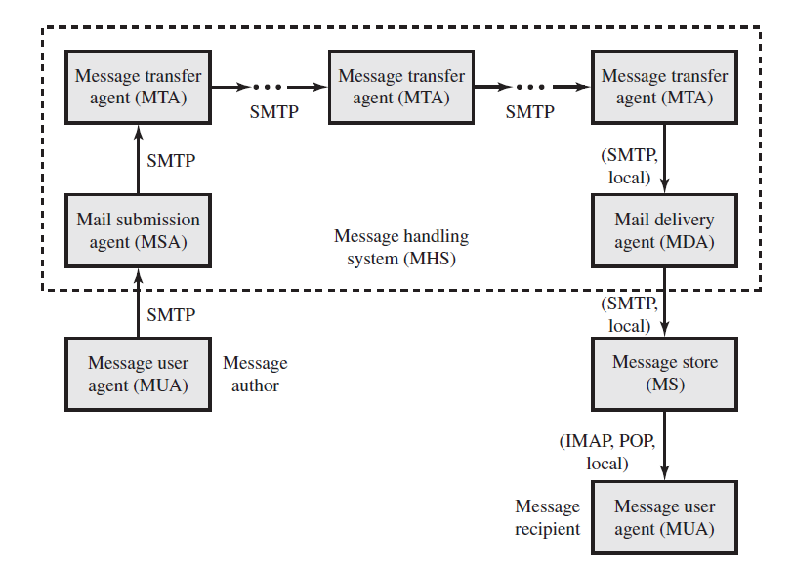
Internet Mail Architecture

Slide 19
Internet Mail Architecture
Message User Agent (MUA)
Works on behalf of user actors and user applications.
The author use sender MUA to formats a message and performs initial submission into the MHS via a MSA.
The recipient MUA processes received mail for storage and/or display to the recipient user
Mail submission agent (MSA)
Accepts the message submitted by an MUA and enforces the policies of the hosting domain and the requirements of Internet standards
Message transfer agent (MTA)
Relays mail for one application-level hop.
Mail delivery agent (MDA)
Responsible for transferring the message from the MHS to the MS.
Message store (MS)

Slide 20
Domainkeys Identified Mail (DKIM)
DomainKeys Identified Mail (DKIM) is a specification for cryptographically signing e-mail messages, permitting a signing domain to claim responsibility for a message in the mail stream.
Message recipients (or agents acting in their behalf) can verify the signature by querying the signer’s domain
DKIM is a proposed Internet Standard (RFC 4871: DomainKeys Identified Mail (DKIM) Signatures).

Slide 21
DKIM Principle
1. S/MIME depends on both the sending and receiving users employing S/MIME. For almost all users, the bulk of incoming mail does not use S/MIME, and the bulk of the mail the user wants to send is to recipients not using S/MIME.
2. S/MIME signs only the message content. Thus, RFC 5322 header information concerning origin can be compromised.
3. DKIM is not implemented in client programs (MUAs) and is therefore transparent to the user; the user need take no action.
4. DKIM applies to all mail from cooperating domains.
5. DKIM allows good senders to prove that they did send a particular message and to prevent forgers from masquerading as good senders.

Slide 22
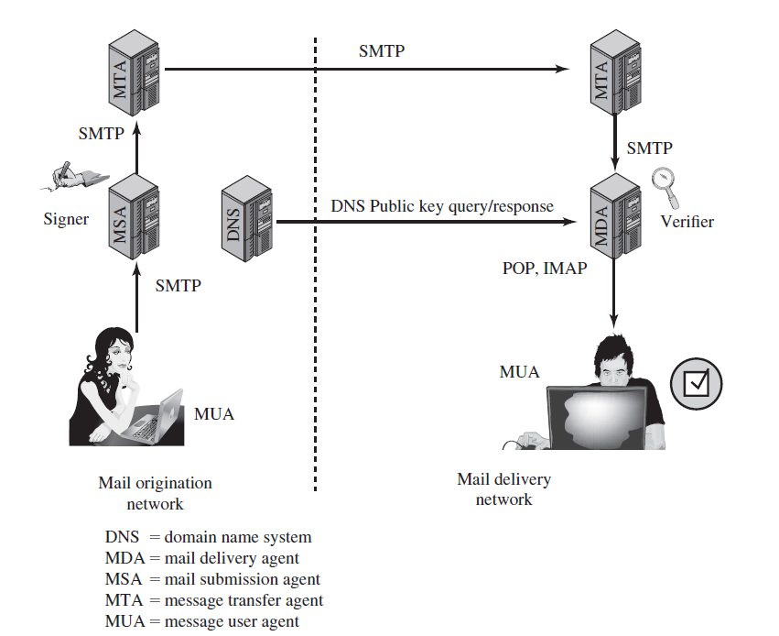
DKIM Operations

Slide 23
S/MIME
MIME is an extension to the old RFC 822 specification of an Internet mail format.
MIME provides a number of new header fields that define information about the body of the message.
MIME defines a number of content formats, which standardize representations for the support of multimedia e-mail. Examples include text, image, audio, and video

Slide 24
S/MIME
S/MIME is defined as a set of additional MIME content types and provides the ability to sign and/or encrypt e-mail messages
Enveloped data: This function consists of encrypted content of any type and encrypted-content encryption keys for one or more recipients.
Signed data: A digital signature is formed by taking the message digest of the content to be signed and then encrypting that with the private key of the signer. The content plus signature are then encoded using base64 encoding. A signed data message can only be viewed by a recipient with S/MIME capability.
Clear-signed data: As with signed data, a digital signature of the content is formed. However, in this case, only the digital signature is encoded using base64. As a result, recipients without S/MIME capability can view the message content, although they cannot verify the signature.
Signed and enveloped data: Signed-only and encrypted-only entities may be nested, so that encrypted data may be signed and signed data or clear-signed data may be encrypted.

Slide 25
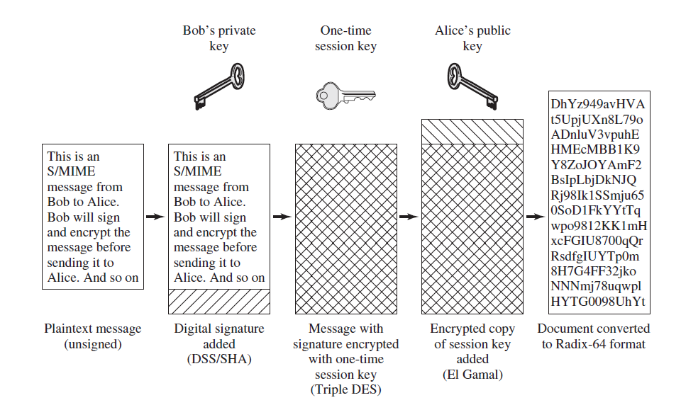
S/MIME

Slide 26
S/MIME: Public-Key Certificates
S/MIME uses certificates that conform to the international standard X.509v3.

Slide 27
SSL/TLS
One of the most widely used security services is the Secure Sockets Layer (SSL) and the follow-on Internet standard known as Transport Layer Security (TLS).
TLS is designed to make use of TCP to provide a reliable end-to-end secure service. TLS is not a single protocol but rather two layers of protocols

Slide 28
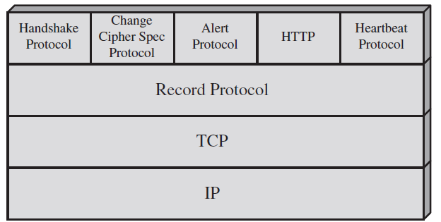

Slide 29
SSL connection – SSL session
Two important TLS concepts are the TLS session and the TLS connection, which are defined in the specification as follows:
Connection: A connection is a transport (in the OSI layering model definition) that provides a suitable type of service. For TLS, such connections are peer-to-peer relationships. The connections are transient. Every connection is associated with one session.
Session: A TLS session is an association between a client and a server. Sessions are created by the Handshake Protocol. Sessions define a set of cryptographic security parameters, which can be shared among multiple connections. Sessions are used to avoid the expensive negotiation of new security parameters for each connection

Slide 30
SSL Record Protocol
The SSL Record Protocol provides two services for SSL connections:
Confidentiality: The Handshake Protocol defines a shared secret key that is used for symmetric encryption of SSL payloads.
Message integrity: The Handshake Protocol also defines a shared secret key that is used to form a message authentication code (MAC).

Slide 31
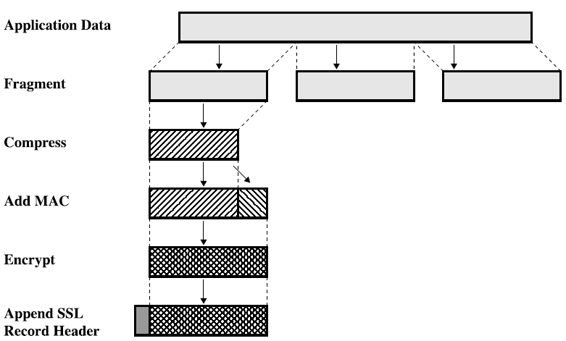
SSL Record Protocol

Slide 32
Change Cipher Spec Protocol
It use the TLS Record Protocol
This protocol consists of a single message, which consists of a single byte with the value 1.
The sole purpose of this message is to cause the pending state to be copied into the current state, which updates the cipher suite to be used on this connection.

Slide 33
Alert Protocol
convey TLS-related alerts to the peer entity
alert messages are compressed and encrypted, as specified by the current state
Each message in this protocol consists of two bytes. The first byte takes the value warning(1) or fatal(2) to convey the severity of the message
If the level is fatal, TLS immediately terminates the connection

Slide 34
SSL Handshaking Protocol
The most complex part of TLS
SSL Handshake consist 4 phase:

Slide 35
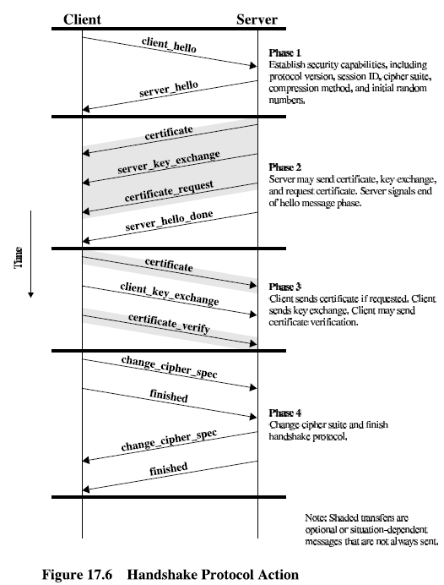

Slide 36
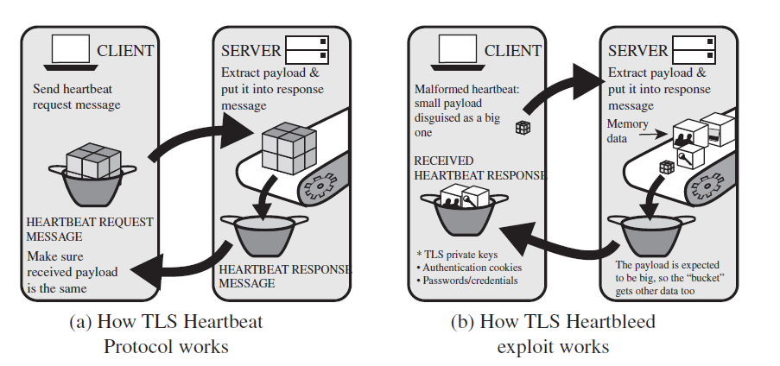
Heartbeat Protocol
The Heartbeat Protocol runs on the top of the TLS Record Protocol and consists of two message types: heartbeat_request and heartbeat_response

Slide 37
SSL/TLS Attacks
Attacks on the Handshake Protocol.
Attacks on the record and application data protocols:
BEAST
CRIME
…
Attacks on the PKI:
Checking the validity of X.509 certificates is an activity subject to a variety of attacks.
Other attacks:
DoS attack
Heartbleed attack
…

Slide 38
IPSec
When IPsec is implemented in a firewall or router, it provides strong security that can be applied to all traffic crossing the perimeter. Traffic within a company or workgroup does not incur the overhead of security-related processing.
IPsec is below the transport layer (TCP, UDP) and so is transparent to applications. There is no need to change software on a user or server system when IPsec is implemented in the firewall or router. Even if IPsec is implemented in end systems, upper-layer software, including applications, is not affected.
IPsec can be transparent to end users. There is no need to train users on security mechanisms, issue keying material on a per-user basis, or revoke keying material when users leave the organization.
IPsec can provide security for individual users if needed. This is useful foroff-site workers and for setting up a secure virtual subnetwork within an organization for sensitive applications.

Slide 39
IPSec
IPsec provides two main functions:
a combined authentication/encryption function called Encapsulating Security Payload (ESP)
Key exchange function: Key management is provided by the Internet Key Exchange standard, IKEv2
Note: There is also an authentication- only function, implemented using an Authentication Header (AH). Because message authentication is provided by ESP, the use of AH is deprecated

Slide 40
ESP: Security Associations
A key concept that appears in both the authentication and confidentiality mechanisms for IP is the security association (SA).
An association is a one-way relationship between a sender and a receiver
An SA is uniquely identified by three parameters:
Security parameter index (SPI) A bit string assigned to this SA and having local significance only
IP destination address
Protocol identifier
Notes:
ESP is often used to implement a VPN
Packets go from internal network to a gateway with TCP / IP headers for address in another network
Entire packet hidden by encryption
Including original headers so destination addresses are hidden
Receiving gateway decrypts packet and forwards original IP packet to receiving address in the network that it protects

Slide 41
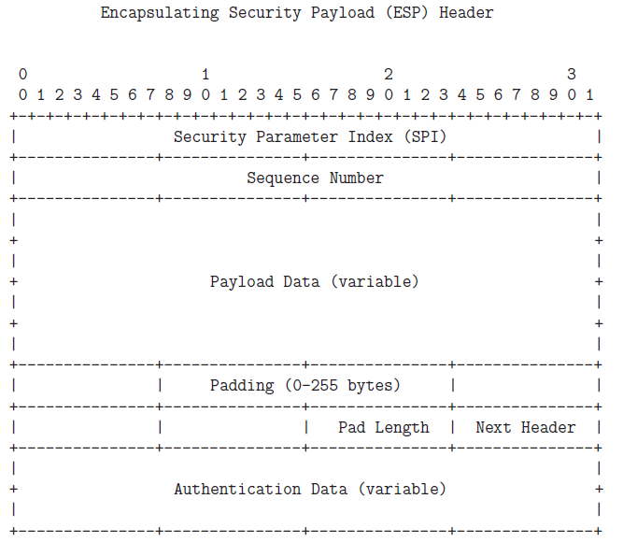

Slide 42
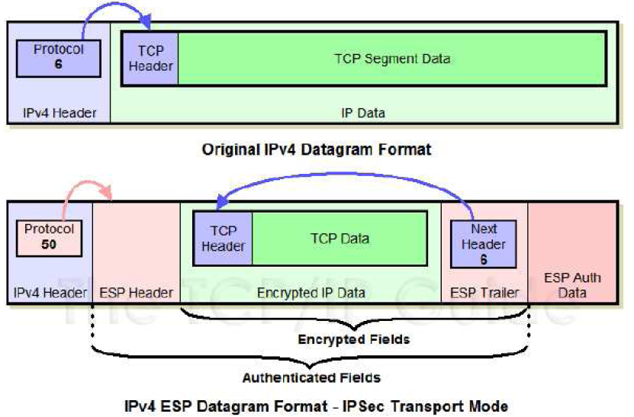

Slide 43
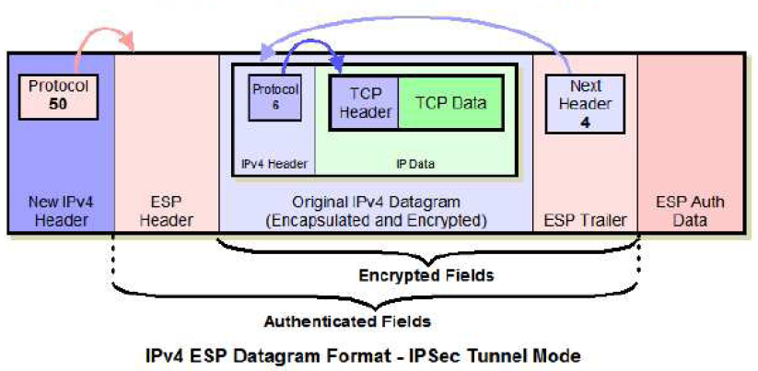

Slide 44
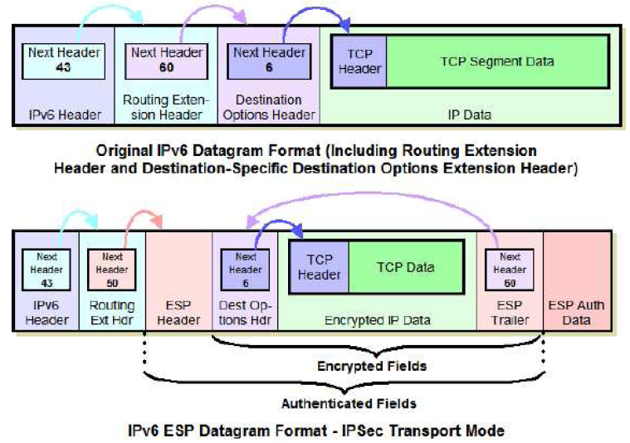

Slide 45
